Slide 1
PERSONAL FITNESS LESSON #2
Basic Muscle Anatomy and Human Movement

Slide 2
Basic Muscle Anatomy and Joints

Slide 3
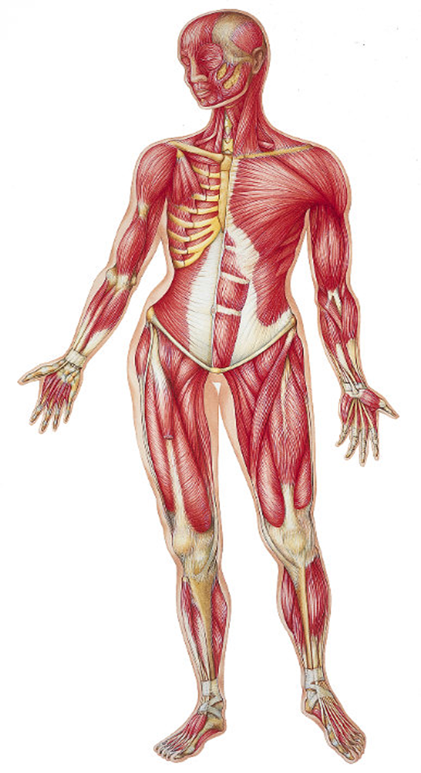
Front View
Pectoralis Major
Biceps
Obliques
Abdominals
Adductors
Quadriceps

Slide 4
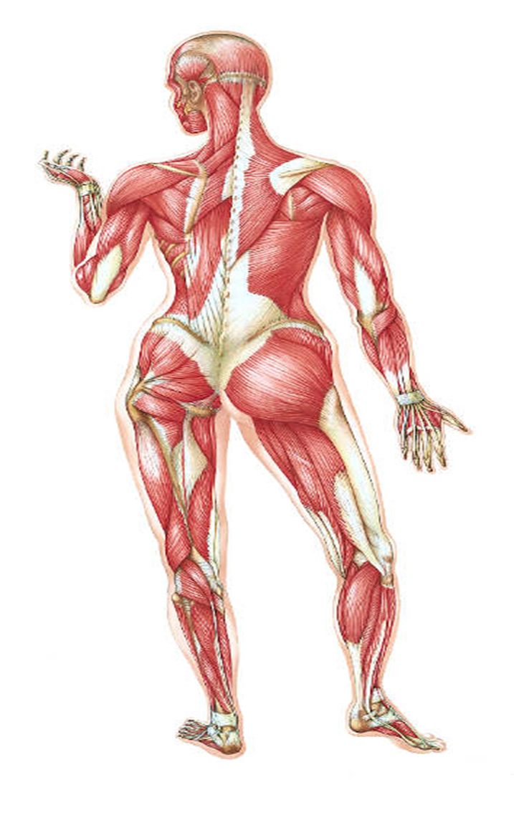
Rear View
4
5
7
6
1. Gastrocnemius
2. Gluteus Maximus
3. Erector Spinae
4. Trapezius
5. Latissimus Dorsi
6. Triceps
7. Deltoids
8. Hamstrings
3
2
8
1

Slide 5
JOINTS
Shoulder Joints
Traps, Lats, Pecs, Delts
Elbow
Biceps and Triceps
Trunk (Core)
Abdominals, Obliques, Erector Spinae
Hip
Gluteus Maximus, Adductors
Knee
Quadriceps, Hamstrings
Ankle
Gastrocnemius

Slide 6
Movements that contract the muscles

Slide 7
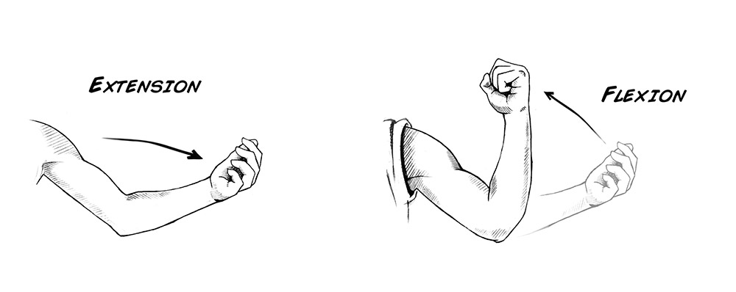
Flexion and Extension
Flexion
The action of bending or the condition of being bent; especially the bending of a limb or a joint
Examples:
Bending the elbow, making a fist, bending the knee
Extension
The opposite of flexion
It is a straightening motion
Examples:
Straightening the knee or the arm

Slide 8
Hyperextension
Excessive joint movement in which the angle formed by the bones of a particular joint is opened, or straightened, beyond its normal, healthy range of motion.
Beyond the normal limits of what the joint is able to do (180 degrees)
A superman is an example where the back is hyperextended compared with a normal position
This is an example where hyperextension is not a bad thing!
Hyperextension isn’t always a voluntary movement because it can happen during an accident or a fall.

Slide 9
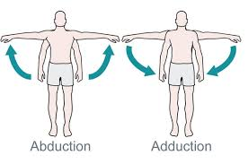
Abduction and Adduction
Abduction
The movement of a limb or other part away from the midline of the body; or from another part.
Example:
Arms during a jumping jack going up
Adduction
The movement of a body part toward the body’s midline
Example:
Arms during a jumping jack on the way down.

Slide 10
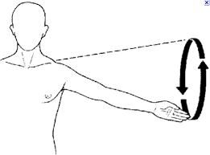
Circumduction
It is a combination of→ flexion, extension, abduction and adduction
It is a circular movement of a joint

Slide 11
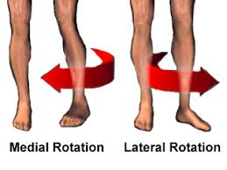
Lateral and Medial Rotation
Lateral (external) rotation:
Rotational movement away the midline
Medial rotation:
Rotational movement towards the midline

Slide 12
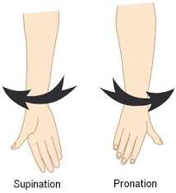
Pronation and Supination
PRONATION→ inward movement or rotation of the forearm or foot
SUPINATION→ outward movement or rotation of the forearm or foot

Slide 13
Conclusion
Any questions from today?
What is something you took away from today!

